Slide 1
Health & Safety In Agriculture

Slide 2
In the last ten years, almost one person a week has been killed as a direct result of agricultural work. Many more have been seriously injured or made ill by their work . Health and safety is a fundamental requirement of a sustainable farming business and should be regarded as an essential part of farm business management. Managing risks in a sensible way protects you, your family, your workers and your business and can bring the following benefits.

Slide 3
Reduction in injuries and ill health and the resulting financial and personal costs.
Improved productivity , good morale and a happier, healthier workforce.
Reduced sickness payments and recruitment/training costs for replacement workers.
Reduced loss of output resulting from experienced and content workers being off work.
Longer life for equipment and machinery.
Less chance of damage to machinery, buildings and product.
Lower insurance premiums and legal costs.
Less chance of enforcement action and its costs e.g. the cost of dealing with an incident and/or fines typically ranging from £500.
Reduced risk of damage to the reputation of the business.

Slide 4
The Costs & Causes Of Deaths & Injuries

Slide 5
Farming is a hazardous industry. The total annual cost of injuries (in farming, forestry and horticulture) to society is estimated at £190 million and around two-thirds of that is due to reportable injuries (£130 million), with fatalities accounting for around another third (£55 million).

Slide 6
Lifting Operations In Agriculture

Slide 7
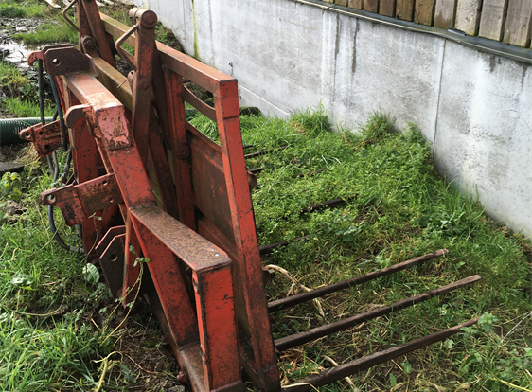
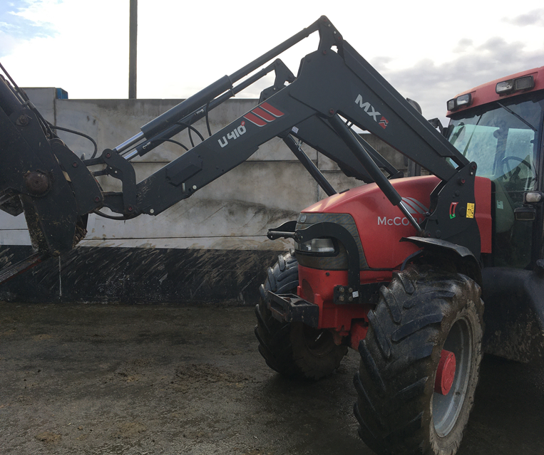
Lifting Operations & Equipment In Agriculture
Lifting operations covers a wide range of equipment in agriculture including:
Tractor fore-end loaders, fork trucks and telescopic handlers (telehandlers).
Workshop block and rope hoists.
Lifting attachments and accessories, for example bale spikes.

Slide 8
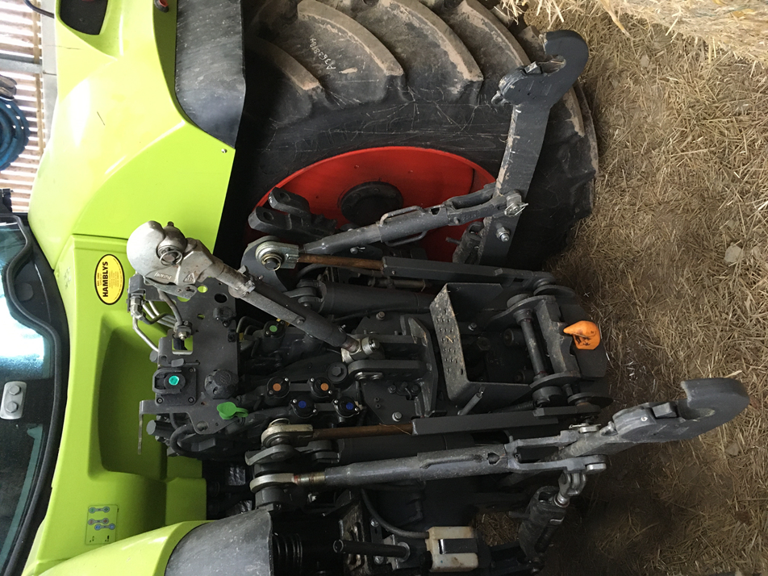
What Is Classed As Non Lifting Equipment ?
The three-point linkage on a tractor, is not considered to be lifting equipment. If used to lift implements and machines designed to be operated on a tractor.

Slide 9
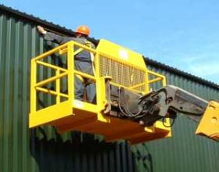
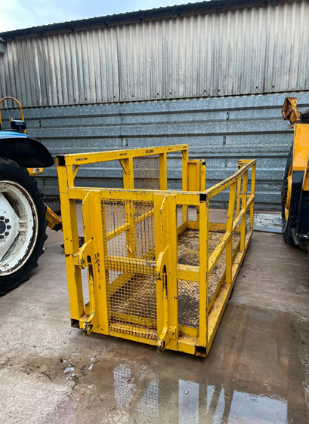
Lifting People With Lifting Equipment
People should only be raised on lifting equipment which is specifically designed for that purpose of lifting people, for example a Work Basket as pictured below. In no circumstances should any persons be lifted by equipment not made specifically for lifting people, such as telehandler forks or buckets. Please be aware that any item that lifts a work basket must be examined every six months.

Slide 10
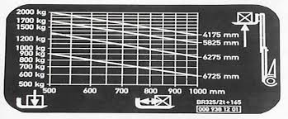
Safe Working Loads Of Lifting Equipment:
A clear safe working is vital for every item of lifting equipment this shows the weight the item can safely lift. For example a work basket may be limited to one person + 70 kg of tools.

Slide 11
Thorough Examination
Thorough Examinations should be carried out by a competent person at the correct intervals, if an item does not carry people it must be examined every twelve months, however if it does carry people it should be examined every six months. Thorough examinations are vital to every piece of lifting equipment, failing to have them carried out could lead to a fine starting from £500 - Unlimited from the HSE. A typical fine for a small business is £5000 upwards.

Slide 12
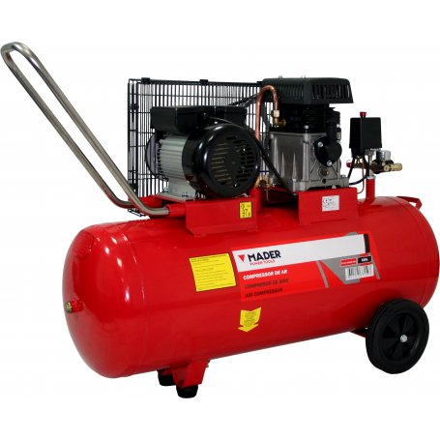
PSSR Pressure Systems
Although an air compressor is not covered by LOLER they are covered by PSSR (The Pressure Systems Safety Regulations) and must still have a thorough examination carried out. An air compressor is a power tool which creates and moves a pressured tool. Air under pressure provides great force , which can be used to power many different kinds of tools .

Slide 13
Oast Engineering What We Do
We are Based in North Devon, we carry out statutory through examinations of a wide range of plant and machinery in accordance with current legislation on a national basis.
Should you have any further queries please do not hesitate to contact us via email; Leesmith@oast-eng.co.uk
Please visit our website for any further information;
www.oast-eng.co.uk

Slide 14
Further Information
https://www.hse.gov.uk/pubns/books/hsg270.htm - Farmwise (Produced by the HSE) gives a good understanding of how employees and employers can stay safe whilst working on farms.
https://www.hse.gov.uk/pubns/indg229.htm - This leaflet gives simple, practical advice on what you can do to eliminate or reduce the risks from work equipment.
https://www.hse.gov.uk/work-equipment-machinery/loler.htm - The LOLER section of the HSE website offers a good understanding of the legal requirements in order to be compliant with the law.
https://www.hse.gov.uk/pubns/books/hsg258.htm - HSG 258 covers the controlling of airborne dust etc that can be hazardous to health.
https://www.hse.gov.uk/pubns/priced/l122.pdf - The Pressure Systems Safety Regulations 2000 (PSSR) cover the safe design and use of pressure systems.

